Slide 1

Sprint 2 Presentation
Bachelor in Applied Information Technology
25/05/2022
Yinghan LING and Joris LEFONDEUR

Slide 2

Summary
Sprint 2 initial planning
Sprint 2 retrospective
Live demonstration

Slide 3

Sprint 2 initial planning
Joris:
capture minigame
departments tilemap
Yinghan:
outside tilemap
NPCs
quest

Slide 4
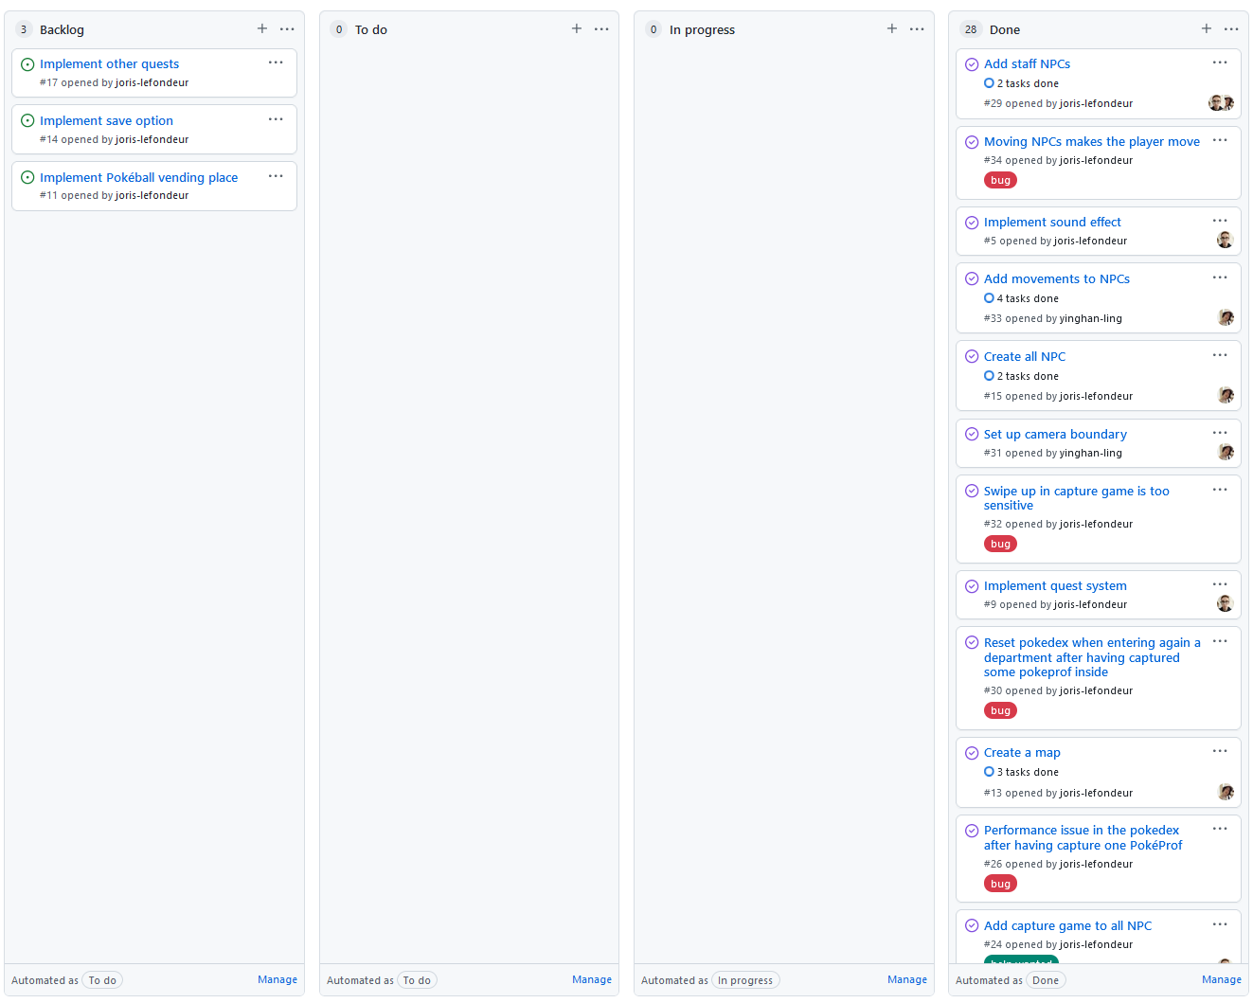
Sprint 2 retrospective
Joris:
capture minigame
departments tilemap
sound effect
inventory
quest
Yinghan:
outside tilemap
NPCs
camera
https://github.com/Group-2-SEP-2022/PokeProf/projects/4

Slide 5


Live demonstration

Slide 6
THANK YOU!

